Slide 1
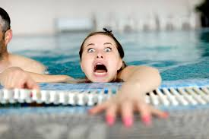
Electronic Design
2b – throwing you in the pool to teach you to swim!

Slide 2
Design challenge
Objective: Design and build a nightlight from a recycled AC or DC adapter (wall wart) and an LED
If you can’t (safely) find one that will never be needed again, use the wall wart that came with your kit
Methods: Meta-method is reductionism – break this task into smaller pieces (it’s already reduced as 2 parts in the Objective, design and construction, so how should we break each of those up?)
A common challenge with reductionism is that complex systems don’t cut easily because of dependencies and connections … once those connections are cut, the system is no longer the same …

Slide 3
Engineering vs. physics
We’ll take a hierarchical, reductionist, engineering approach
That means we’re not interested in understanding every step to ever deeper levels of analysis (physics), but in doing minimal work and understanding to get the job done.
Let’s break the task into 5 parts:
Design – figure out how and what to do
Prototype – verify that works
Construction – make it clean, pretty, robust, and safe
Validation & Reflection – did it come out the way it was designed? What worked or didn’t? What might we have done differently (i.e., easier?)
Documentation – write a report (and do more meta-cognition)
Note that in reality, this rarely is a linear process. E.g., prototype failures or construction challenges may warrant redesign … so actual engineering involves circular, repetitive, iterative, non-linear progress …
Don’t expect things to work the first (or 2nd or … time)
Notes:
Recall in the introductory, online materials, I said that like a foreign language, there isn’t a unique place to start. We’re jumping in to conversation now. Expect that you’re not going to understand everything, but please slow me down, ask questions, so more of this makes sense. We’ll come back later and review this process multiple times …

Slide 4
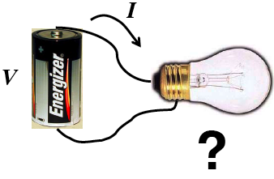
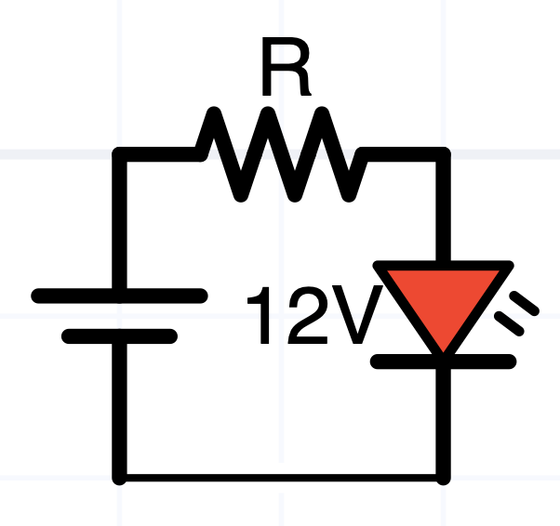
1. Design
If we connect an LED to a 12V 1A power supply, we might see a transient SED (smoke emitting diode)
That is an irreversible process … evidence of the empirical theory that semiconductors (and many electronic devices) function because of smoke. When the smoke comes out of them, they no longer work, so therefore …
A series resistor is necessary to limit the current i and power P = Vi [1] ➔ what value??
i
[1] Which V, which i?

Slide 5
Characteristic (I-V) Curves

Slide 6
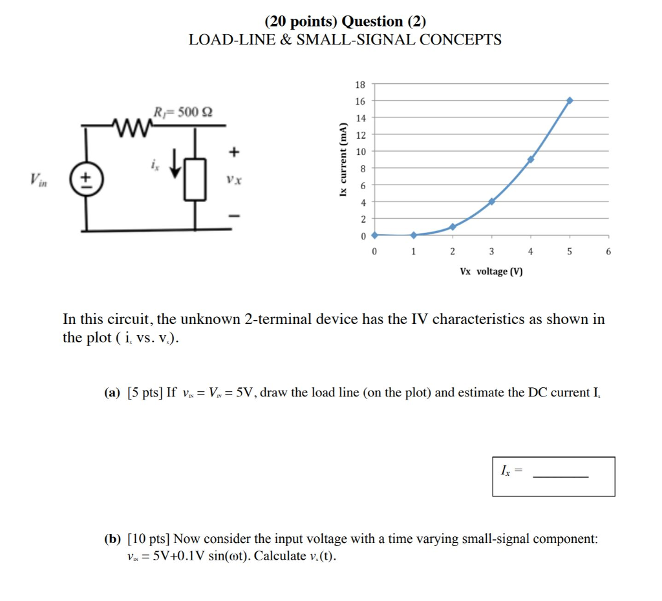
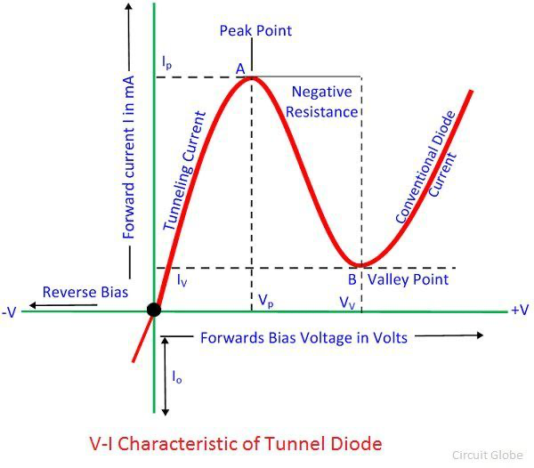
I-V curves describe any 2-terminal device
Any 2-terminal electrical device can be characterized by how the voltage across it and current through it are related
Voltage and current are not independent …
If V=0 independent of I, that’s called a short circuit, or a wire
If I = 0 independent of V, that’s called an open circuit
If V and I are proportional, i.e., V = IR, that’s called a resistor
Diodes may be modeled as “piecewise linear” – except where they’re not, around their “knee” (almost everywhere else they’re nonlinear …
Edison light bulbs are nonlinear: as the filament heats up, its resistance increases, and the I-V curve slope = 1/R decreases.
In some regions of an I-V curve, it’s possible for, dI/dV = 1/R < 0, i.e., negative resistance

Slide 7
Curve Tracers
Curve tracers are electronic test devices that measure I-V characteristic curves
Take the curve tracer out of your toolbox … ;-)
Actually, these aren’t very common any more
Usually we rely on information in the component’s datasheet
We’ll measure some I-V curves too

Slide 8
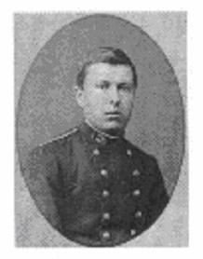
Design challenge
Objective: Design and build a nightlight from a recycled AC or DC adapter (wall wart) and an LED
Methods:
Reductionism: Characterize the wall wart and the LED
What’s relevant regarding design? (I.e., the equivalent of “m” in the a = F/m problem, or R in the lightbulb and battery problem?
A wall wart is to first order a voltage source with voltage V.
A more accurate model uses 2 parameters*, V_{Thevenin} = V_{Th} in series with R_{Thevenin} = R_{Th}
Thevenin’s theorem is very powerful and useful in modern electronics, in spite of its age (1882)
V_{th} and R_{th} aren’t physical batteries or resistors, but equivalents – a 2 parameter model of the circuit
https://en.wikipedia.org/wiki/Thévenin%27s_theorem

Slide 9
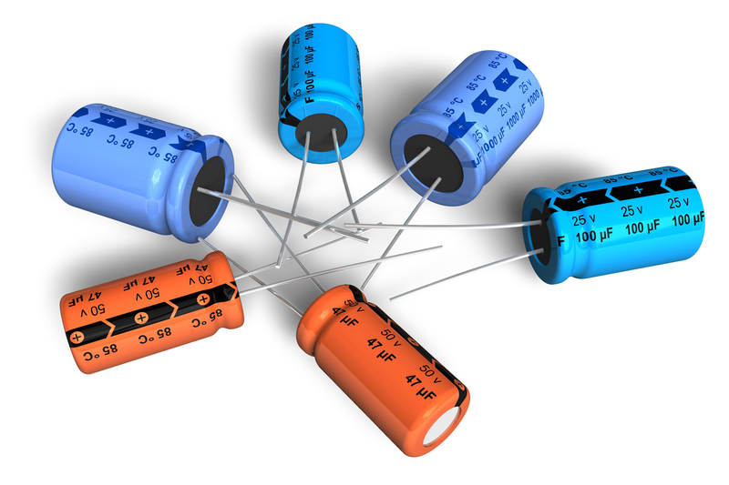
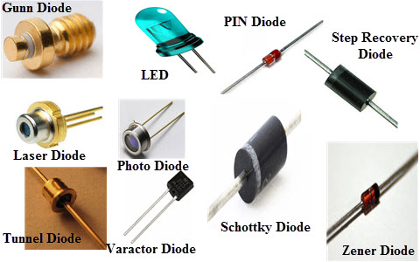
Polarized Components
Some components, like resistors and wires, are symmetric with respect to positive and negative currents
Diodes, some capacitors, and most other devices aren’t – and behave very differently backwards vs. forwards
Electrolytic capacitors can violently explode if the negative terminal is more positive than the positive terminal → be careful
The negative terminal generally has a stripe
Diodes often have a bar or flat side on the cathode (negative)
I often feel the flat side of an LED easier than I can see it
Manufacturer data sheets and component testers are useful

Slide 10
Solderless breadboards
A quick way to connect small components
Not as reliable as solder, but are much faster
Problematic at high frequencies and high currents
Common mistake is placing a component in a row, which shorts its leads
Connected are: a-e, f-j, and the 2 pairs of strips next to red and blue Note that the 2 reds and 2 blue columns are NOT connected to each other unless you put a jumper wire between them

Slide 11
Preparing the wall wart
Cut the connector with ~8” of cord off the end of the wall wart – you’ll need this wire and plug later (8.5” = width of a sheet of paper)
Spread the 2 wires apart, cut one ~1/4” (6mm) shorter than the other, and strip 1/8” (3mm) of insulation off each wire
Solder 1/4” (6mm) of solid wire (e.g., a resistor lead) to each end
Plug in and measure the voltage between the wires, noting the polarity – is the long one positive or negative relative to the short one?
This is called V_{thevenin}, or the “open circuit voltage”
¼”

Slide 12
Measuring V_{th} and R_{th}
V_{th} = V_{open circuit} so make sure the leads aren’t shorting (touching), plug the wall wart in, and set the meter to VDC

Slide 13
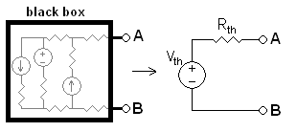
Measuring R_{Th}
Your LED will “want” a few mA in order to not be too bright nor dim, so we want to measure R_{th} of the wall wart when it’s outputting a few mA (in case it isn’t constant)
i
R_{L}
V_{L}
First assume R_{th} = 0 and choose R_{L} = V_{th} /i_{LED} (why??)
Connect R_{L} to the power supply and measure V_{L}.
R_{th} and R_{L} divide V_{th}:

Slide 14
Measuring R_{Th}
This is just the voltage divider equation (which you already memorized ;-), because R_{th} and R_{L} are in series.
i
R_{L}
V_{L}
We measured V_{th} (= V_{open circuit}) without R_{L}, we chose R_{L} and measured V_{L} so this equation has one unknown: R_{th}.
An ideal voltage supply has R_{th} = 0, so don’t be surprised if yours is very close to that
This is much more practical than the Wikipedia method

Slide 15
Characterizing the LED
General LED behavior
I~0 for V_{LED} < V_{f} (typically 1.5-2.5V), the forward voltage
Light is roughly proportional to current
Current increases crazy fast for V>V_{f}
Current ~ 0 for V < V_{f}
Operating a LED safely requires a regulated current source, not a voltage source
How does your LED respond?
How do you safely test it without destroying it??
If only you had a regulated current source …
Fun fact: a regulated voltage source in series with a big resistor behaves just like a current source ...
Why?
What does “big” mean? We‘ll explore this later ... (Matlab file: voltageAndCurrent.mlx)
Note: I grabbed this curve off the ’net. 10mA is hot for our small LEDs

Slide 16
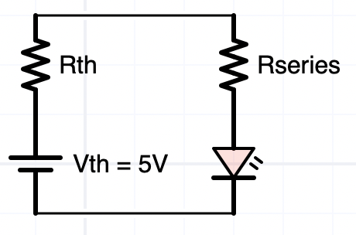
Characterizing an LED
Never connect an LED to a voltage source without a current-limiting series resistor
To find the LEDs characteristics, assume worst cases, V_{f} = 0 and Rth = 0, so Rseries = Vth / Imax, the maximum safe LED current which for small LEDs is ~10 mA
You can now measure V_{f} across the LED and measure i = V_{R}/Rseries
To measure the LEDs I-V curve, we need to increase Rseries (decreasing it risks burning out the LED)

Slide 17
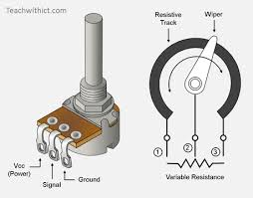
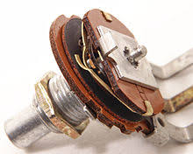
Don’t smoke your pot
A potentiometer consists of a long resistor with a movable contact (“wiper”)
The resistance between one end and the contact (typically the center pin) can vary between ~0Ω and the value of the pot
If the pot is the only current limiting device in a circuit with a voltage source, and you turn the pot toward zero … then excess current can flow and burn the pot
So ALWAYS make sure there’s some other current-limiting device in series with a pot and a voltage source

Slide 18
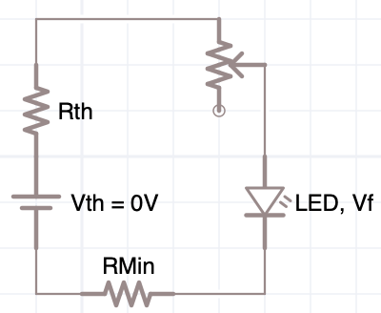
Measuring your LED I-V curve
Assume (for now) that V_{f} (and R_{Th}) = 0, and find a resistor close to R_{Min} >~ V_{Th}/(10mA)
Use your solderless breadboard to connect the wall wart cable, R_{Min}, a potentiometer, and the LED in series.
Measure V_{LED} and i = V_{RMin}/R_{Min} (a cliplead help)
Make a table of V_{LED}, V_{RMin}, I, and your perception of the brightness
Pick the i that you like and compute R_{series}
i
V_{LED}
V_{R}
V_{R} | V_{LED} | I | brightness
Plot the I-V curve (column 2 and 3)

Slide 19
Don’t melt your breadboard
Keep in mind what rows and columns are connected in the breadboard … your circuit should look something like this
A trick: Measure –V_{R} and flip the sign in your head
Clip lead the black voltmeter probe to the common connection of R_{min} and the LED, and move the red lead between the other sides of R_{min} and the LED
i
V_{LED}
R_{min} serves 2 purposes: it limits the current to protect the LED, and indicates the current in the series circuit
-V_{R}

Slide 20
Measuring your LED I-V curve
The yellow and blue jumpers make those 2 measurement points easier to reach (and safer – avoiding possible short circuiting something with the voltmeter probe)
Here I’m measuring –V_{rmin} touching the blue pin; moving the red probe to the yellow pin in column 13 measures V_{LED} (the probe tip is touching the jumper pin, not the what plastic in the columns)

Slide 21
I-V Curve
How many data points should you measure?
Enough to have confidence the curve you draw is correct
Really we only need to find just 1 point on the curve, where we want our night light to operate – not too bright nor too dim
Don’t forget to make a note of what current (brightness) you want to operate your night at
Later we’ll use our Arduinos to measure 100s of points on this I-V curve in a fraction of a second
I
V_{R} | V_{LED} | I | brightness
V

Slide 22
Plotting data in Matlab
%% LED I-V curve
% 4 feb 21 BR
data = [ ... % Vr Vd
0 0
.912 2.66
1.28 2.677
1.708 2.693
.156 2.59
.009 2.488
3.203 2.737
% 0 -12.21
];
[foo, indx] = sort(data(:,1));
data = data(indx,:);
Vr = data(:,1);
Vd = data(:,2);
Rmin = 1015; % ohms
Id = Vr / Rmin * 1000; % mA
plot(Vd, Id, 'o-');
xlabel('Vd/volts');
ylabel('Id/mA');

Slide 23
Reflection
How did we find an I-V curve without a variable power supply (i.e., with just a wall wart)?
Where did you measure i?
Why is it so important that R_{Min} is not too small?
What components are polarized and what happens if a polarity is wrong?
THINK ABOUT THESE BEFORE GOING TO NEXT SLIDE
i

Slide 24
Reflection
How did we find an I-V curve without a variable power supply (i.e., with just an uncharacterized wall wart)?
The potentiometer and R_{Min} are 2 resistors in series, R_{series} = (R_{Pot} + R_{Min}). They determine the current, the diode’s characteristics deter- mine V_{LED}.
Where did you measure i?
Since everything is in series, i is the same everywhere. Easiest to measure it as a voltage across R_{Min}, since that resistance is constant and accessable.
Why is it so important that R_{Min} is not too small?
R_{series} = (R_{Pot} + R_{Min}) > R_{Min}. If R_{Min} is too small, then if R_{Pot} gets small, too much current will flow through the LED and burn it up.
i

Slide 25
Questions?

Slide 26
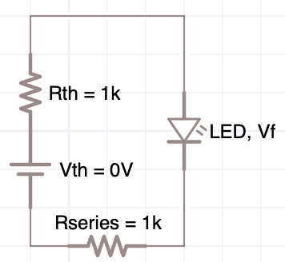
Night Light Design
We measured the I-V curve our LED, chose an operating point (i_{LED}), and know its corresponding V_{f}
We characterized our wall wart as a Thevenin circuit with measured V_{th} and R_{th}
How do we complete the circuit to achieve i_{LED}?
Write an equation for Rseries using KVL
-V_{th}+iR_{th}+V_{f}+iR_{series} = 0
One equation with 1 unknown …
Are we done with design??
i

Slide 27
Night Light Design
Almost done …
What voltage, current, & power, will each component experience?
Compute with Ohms’s and Watt’s Laws
What practical constraints, trade-offs do we make?
Use component values that you have …
Welcome to the art of electronic design … engineering.

Slide 28
3. How do we build it robustly?
Prototype to verify design
Solder and heat shrink are cool technologies …
Soldering is an art ...
Takes lots of practice ... and messing up ...
for i=1:N
Practice
Watch some online videos;
Practice;
end

Slide 29
Some Soldering Tips
Make sure iron has a dab of clean oxide free molten solder on it …
If solder won’t stick to the iron then fix the iron before proceeding ...
Molten solder conducts heat much better than dry iron
Make sure iron is only as hot as necessary ...
Reduces oxide formation, risk of damaging parts and fingers, ....
Knowing some solder physics can help
60/40 vs eutectic solder and phase diagrams
Lead free solder
Look at wetting angles (surface tension)
Pre-coat both surfaces with oxide free solder
Put heat shrink over wires before soldering them
Consider using a heat sink

Slide 30
Other construction tips
Keep uninsulated wires short and offset connections to reduce likelihood of shorts
Cover with heat shrink and/or electrical tape – if the resistor won’t overheat from thermal insulation
Otherwise use multiple resistors …

Slide 31
“Smoke testing”
Are we ready to plug the thing in?
What tests might we do first?
Careful visual inspection always – it’s easier (and safer) to fix mistakes before smoke comes out
…
What could possibly go wrong?
Plan for failure
How will you know if the circuit is working or if it isn’t??
Before doing an experiment, do you have a hypothesis and a method for testing it?

Slide 32
Lab Report Due in a Week
Objective: Recycle a wall wart into a LED night light
Methods:
How you found the Wall Wart’s characteristics: V_{th} and R_{th}
How you found the LED’s I-V curve and characteristics: V_{f} and I
How you designed a circuit that operates at the desired i
Construction techniques
Results
LED I-V curve and V_{f}
Wall Wart’s Thevenin equivalent
Final schematic and explanation
Validation – measurements of all the V’s and I’s in the circuit
Discussion
What worked, what didn’t, why? Any surprises?
How did the rated voltage & current on your wall wart relate to what you measured?
How much power will your night light use, and what is its monthly cost to use? How can you further reduce that cost and should you?
Don’t forget schematics, photos, …

Slide 33
Reflections
What are some things you learned from this?
How did it feel to jump right in the fire, and engineer an LED nightlight?
Did we achieve our goals??

Slide 34
Did we achieve our goals?
I expect that you built a spectacularly working nightlight that you can proudly use at home …
I said, “we’re not interested in understanding every step to ever deeper levels of analysis, but in doing minimal work and understanding to get the job done.”
Was this exercise “minimal”?
What steps were superfluous or unnecessary?
Where might we have gone much deeper?

